Slide 1
Grammar Schools
#edforall
Tweetable graphics #edforall
Graphics courtesy of Education Datalab: http://educationdatalab.org.uk/wp-content/uploads/2016/09/Grammar-schools-research-briefing-September-2016.pdf

Slide 2
Right click the image
Click “Save as Picture”
Upload to your social media using #edforall
Graphics courtesy of Education Datalab: http://educationdatalab.org.uk/wp-content/uploads/2016/09/Grammar-schools-research-briefing-September-2016.pdf

Slide 3
Right click the image
Click “Save as Picture”
Upload to your social media using #edforall
Graphics courtesy of Education Datalab: http://educationdatalab.org.uk/wp-content/uploads/2016/09/Grammar-schools-research-briefing-September-2016.pdf

Slide 4
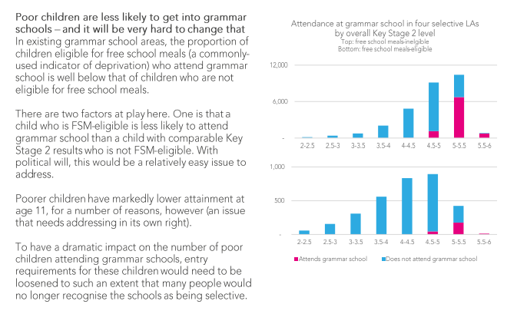
Right click the image
Click “Save as Picture”
Upload to your social media using #edforall
Graphics courtesy of Education Datalab: http://educationdatalab.org.uk/wp-content/uploads/2016/09/Grammar-schools-research-briefing-September-2016.pdf

Slide 5
Right click the image
Click “Save as Picture”
Upload to your social media using #edforall
Graphics courtesy of Education Datalab: http://educationdatalab.org.uk/wp-content/uploads/2016/09/Grammar-schools-research-briefing-September-2016.pdf

